Slide 1

Zomato Restaurants
Analysis
Vaibhav Mishra
19/07/2024

Slide 2
PROBLEM STATEMENT
The primary objectives to the analysis include
Analysing the dataset to identify countries where there is less competition.
Deciding the locations for opening new restaurants.
Creating a dashboard in order to analyse different relationships between attributes.
The analysis aims on data driven approach to expansion in order to maximize revenue and ensure good feedback.

Slide 3

About Zomato
Zomato is an Indian food delivery company and restaurant aggregator.
Zomato provides information, menus and user-reviews of restaurants as well as food delivery options

Slide 4
DATA OVERVIEW
Number of Countries mentioned in the dataset: 16 with India being the biggest in terms of number of restaurants.
Data is from the years 2010-2018
The categorical columns in data include
CountryCode
Restaurant ID
Address
Restaurant Name
Locality
Locality Verbose
Cuisines

Slide 5
DATA OVERVIEW
City
Price Range
Rating
Has_table_booking
Has_Online_delivery
Is_delivering_now
Switch_to_order_menu
Currency
In addition to this, the table also includes an average_price_for_two column which tells the average price in the local currency.

Slide 6
Analytical methods used
Data Cleaning: Utilized approaches like missing value handling, removing duplicates in order to ensure data accuracy.
Enhanced dataset using lookup functions, left functions to extract Year from Datekey_Opening column.
Descriptive Analysis: Used Pivot Tables for an analytical approach making the data more readable and concise.
Visualization: Used pivot charts to maximize simplicity and readability of the data along with slicers for easy control.
Applied sort and filters to analyse the specific data that was required for the analysis.

Slide 7
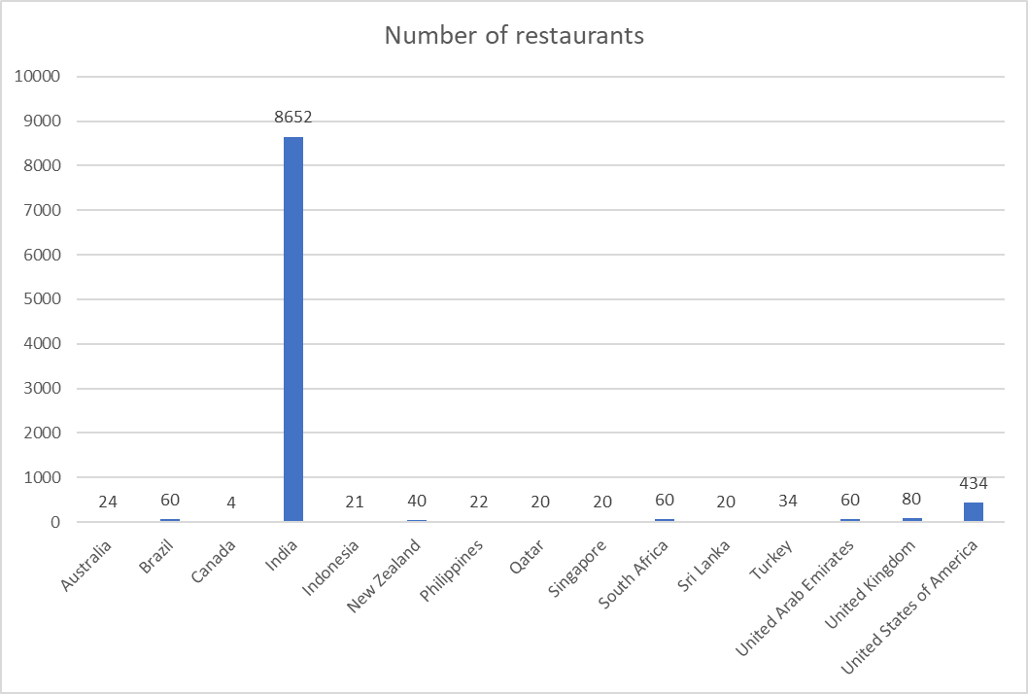
Analysis of Number of Restaurants
Key Insights:
The number of restaurants in the data are in India by a very large majority
US is the second in terms of number of restaurants.
All the other countries are almost at the same number of restaurants as the rest.
Recommendations:
To choose new locations the countries that should be prioritised are the ones with fewer restaurants already present.
Choosing the locations should be based on other factors since the competition is less varied in most of the countries

Slide 8
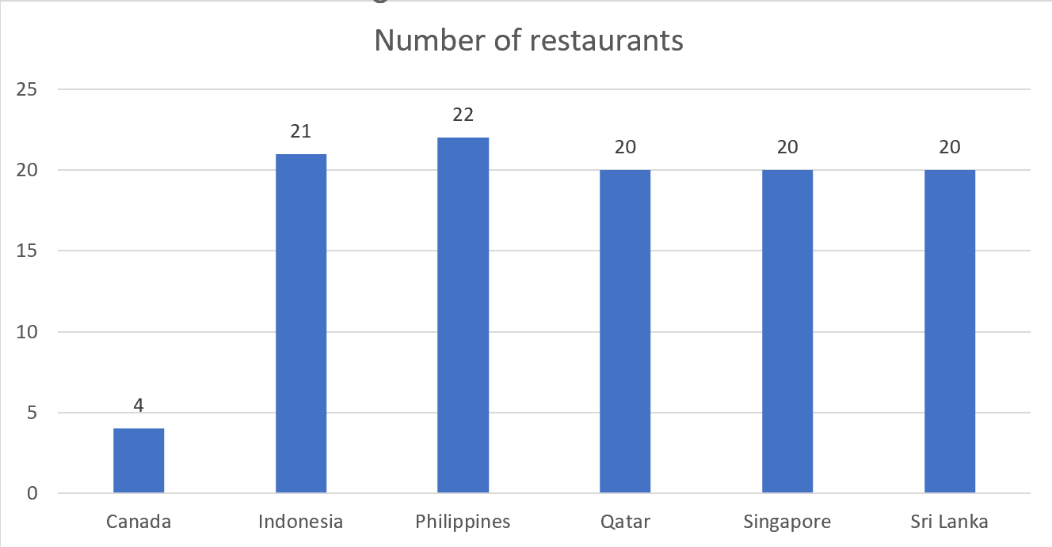
Countries Recommended for Expansion
Key Insights:
Canada has the lowest number of restaurant with all the others hovering in an approximately similar range.
More number of restaurants are in the Asian Market with more focus on Asian cuisines.
In order to expand our portfolio of restaurants we must choose the locations of the new restaurants based on this dataset since our priority is lesser competition.

Slide 9
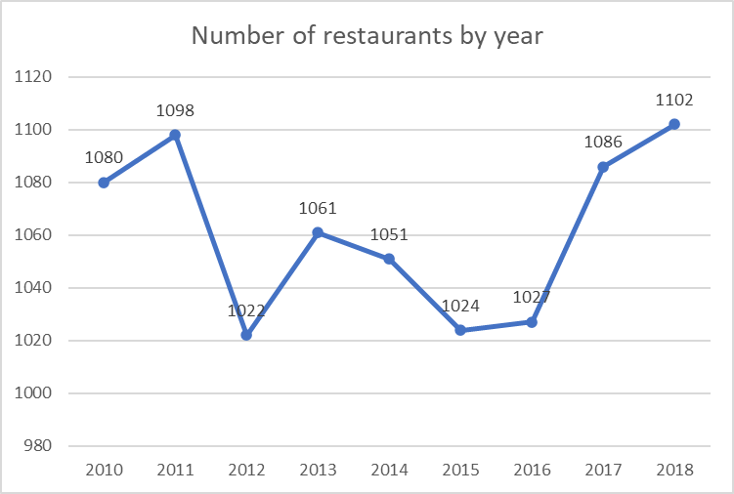
RESTAURANT YEAR OF OPENING
Key Insights:
The number of restaurants by year is not varied hugely.
For the last 3 years, the number of restaurants being opened are at an increasing trend.

Slide 10
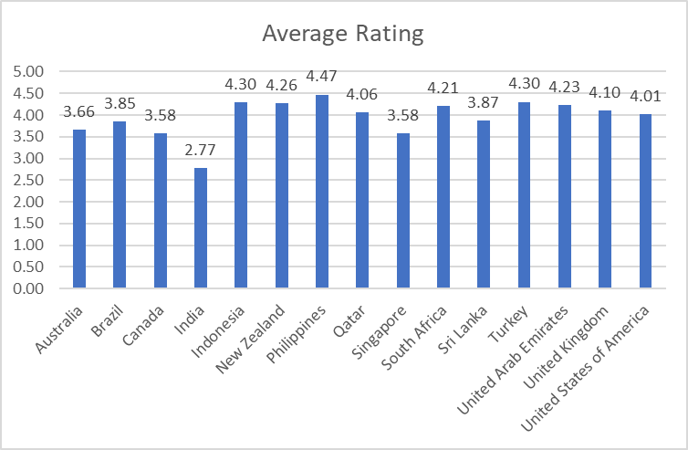
Average Rating by Country
Key Insights:
Indian restaurants have the lowest average rating of all of the restaurants.
Philippines has the highest average rating.
The average rating of all the restaurants W.R.T. their countries is not largely varied.
This indicates a huge focus on customer service

Slide 11
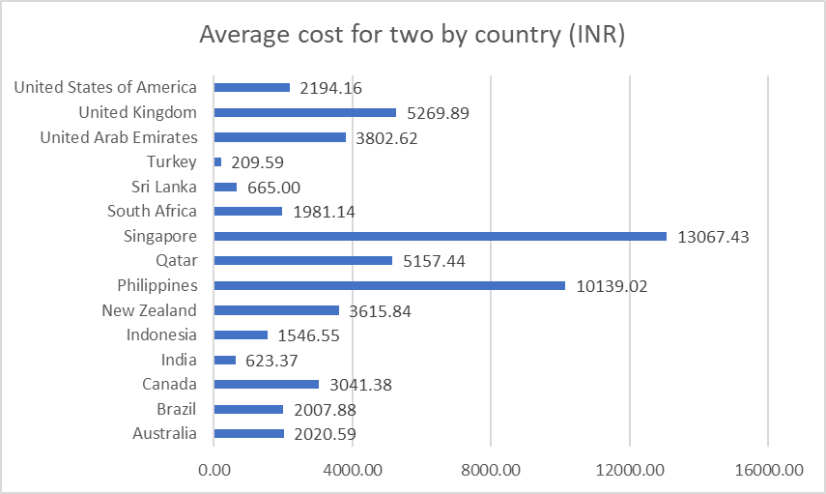
Average Cost for two by Country
Key Insights:
The average cost for two is largely varied across countries.
Turkey has the least average cost for two.
The difference between highest and lowest average cost for two is 12800 INR.
This shows we have a lot of potential for revenue generation.
Recommendations:
In order to ensure maximum revenue, Singapore, Philippines and Qatar should be prioritized

Slide 12
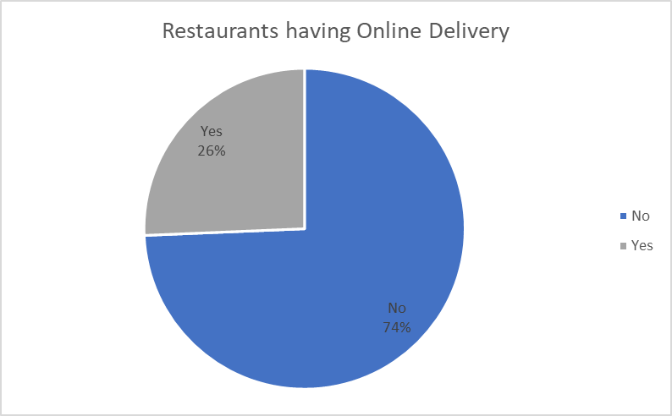
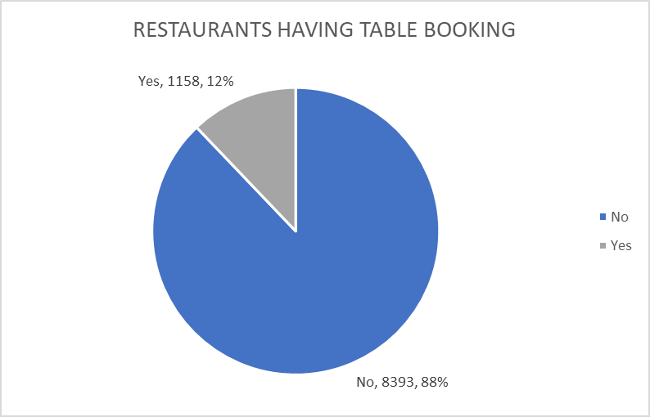
Key Insights:
RESTAURANTS HAVING DELIVERY & BOOKING
A large majority of the restaurants do not have online delivery option.
Online delivery and table booking is not prioritised for the restaurants.
Recommendations:
New restaurants should have Online Delivery and Table Booking features.

Slide 13
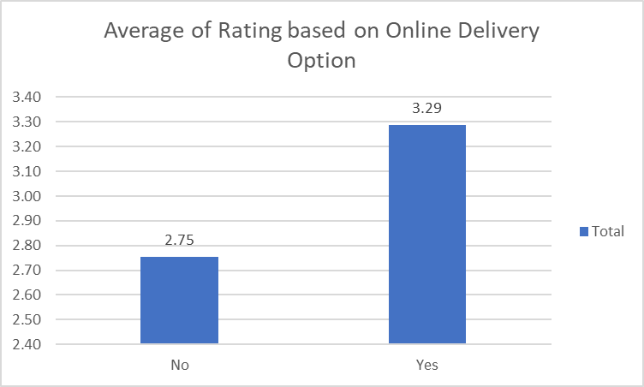
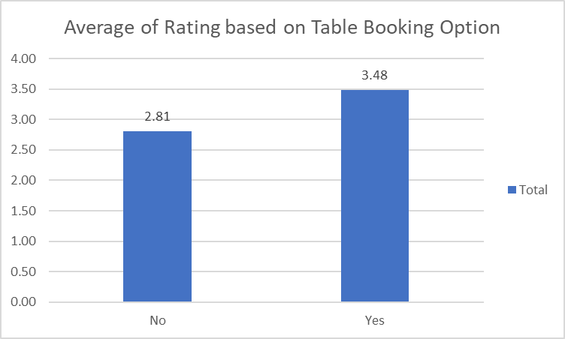
Key Insights:
AVERAGE RATING BASED ON FEATURES
Restaurants having no online delivery or table booking have the lowest average rating.
The rating increases significantly with adding online delivery and table booking options.
Recommendations:
Options for table booking and online delivery should be prioritized in new restaurants

Slide 14
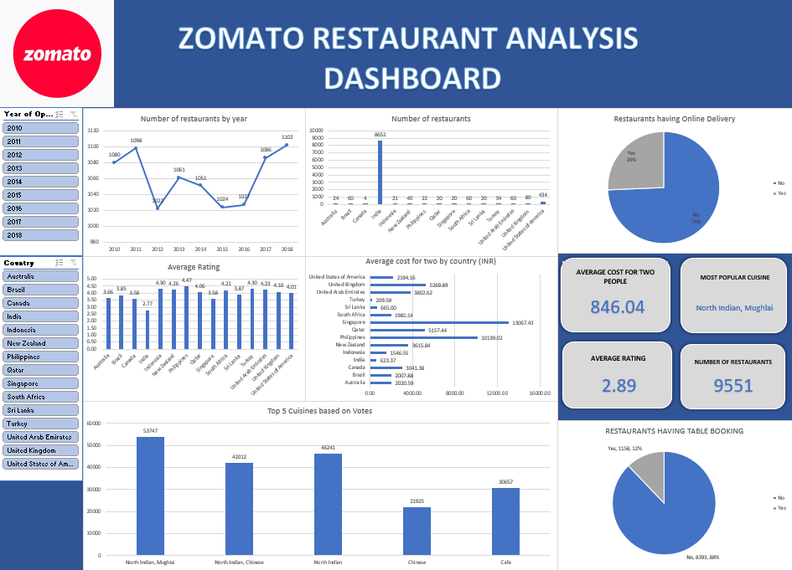
DASHBOARD AND VISUALISATIONS

Slide 15
DASHBOARD AND VISUALISATION
The dashboard includes graphics and visual charts of the key pointers in solving our problem statement.
Number of restaurants by Year of Opening
Number of restaurants by country
Average rating of restaurants by country
Average cost for two by country
The dashboard also includes slicers based on country and year to ensure interactivity.

Slide 16
SUMMARY
The major insights from the data include:
Customer service is a huge priority in the restaurant market.
To ensure better revenue the number of cuisines should be kept at a mean value of the number of cuisines in the market.
Features like Table Booking and Online Delivery have a major impact on the customer ratings.

Slide 17
CONCLUSION
Any new restaurants should be opened in the following countries to ensure better revenue and lesser competition:
Canada
Indonesia
Philippines
Qatar
Singapore
Sri Lanka
The rating of restaurants is hugely dependent on whether it has table booking and online delivery options.
The average cost for two has a vast difference between the higher and lower ends of the spectrum.

Slide 18
RECOMMENDATIONS
In order to ensure higher revenue, the restaurants in countries with better average cost for two should be prioritised.
All the new restaurants being opened should have online delivery and table booking options.
Restaurants should focus on customer service more since it has a direct correlation with the average rating and revenue.
Number of cuisines should be around 4-5 to ensure better rating.

Slide 19

ACKNOWLEDGEMENT AND REFERENCES
Zomato Data, 2010-2018
Storytelling in Presentations, Tom Becker
Excel Dashboards, CFI Team
“What Is Data Cleaning and Why Does It Matter?”, Will Hillier

